Slide 1

Working with Assistants Part 1: Creating Assistants

Slide 2
Alexander Lee
“Michelangelo continually had trouble with his assistants and had to sack several for poor workmanship, laziness, or even - in one particular case - because the lad in question was 'a stuck-up little turd’.”

Slide 3



Notes:
https://www.youtube.com/channel/UC35ZpwldGw7ZJ5R-2sLijzw

Slide 4
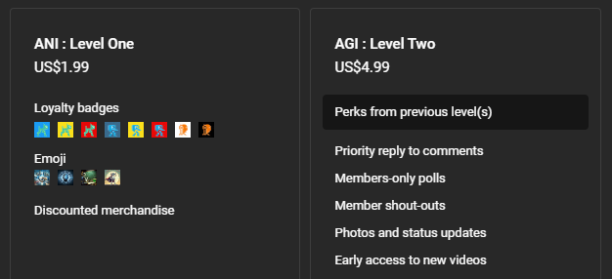

Membership has its privileges
Notes:
https://www.youtube.com/channel/UC35ZpwldGw7ZJ5R-2sLijzw/join

Slide 5
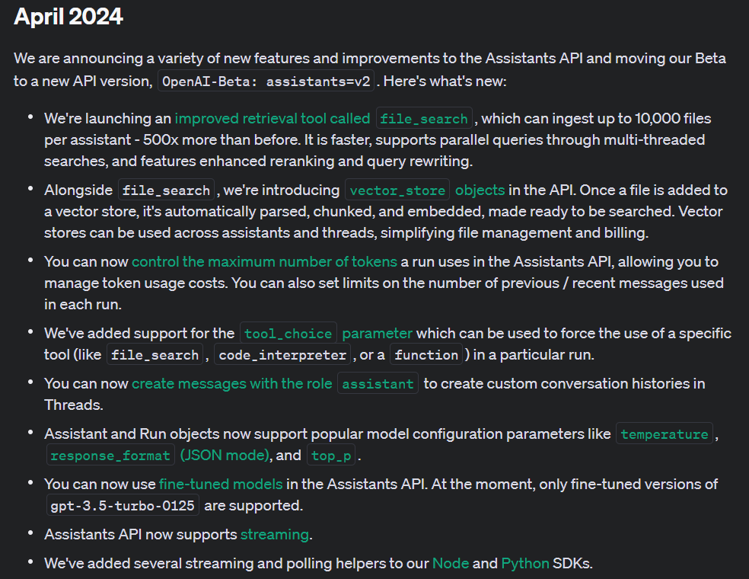
Notes:
https://platform.openai.com/docs/assistants/whats-new

Slide 6
Creating Assistants Using the Interface
Click Your Way to Success!

Slide 7
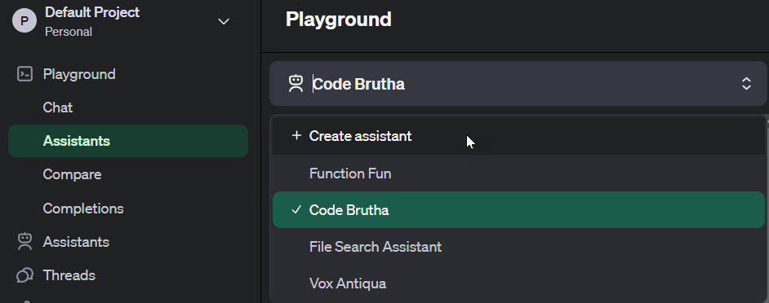
Creating Through the Playground

Slide 8
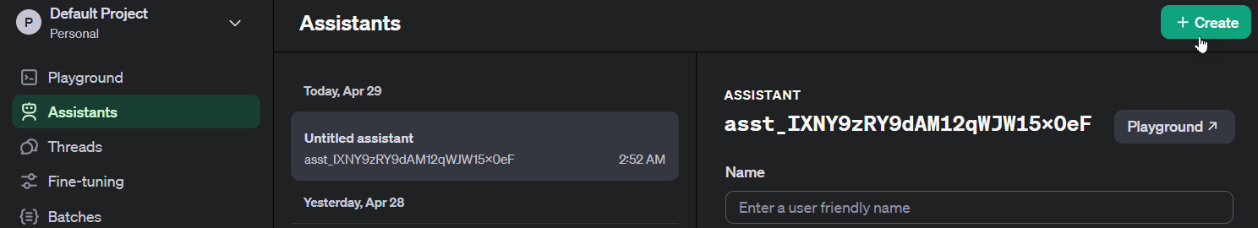
Creating Through the Assistants Area

Slide 9
Demo: Creating Assistants Through the Interface

Slide 10
Demo: Calling Pre-Existing Assistants with Code
from openai import OpenAI
client = OpenAI()
my_assistant = client.beta.assistants.retrieve("asst_2Y9kU1ZtaqtHNbNm83s78CV1")
print(my_assistant)
print("\n\n")

Slide 11
